Slide 1
Demo 1: Employee hierarchy
Stefan Vladkov

Slide 2
The task
You are given a hierarchy of employees in a company. The hierarchy is represented by pairs of Leader – Employee. Implement a method that takes two employees and finds the lowest common leader of both of them.

Slide 3
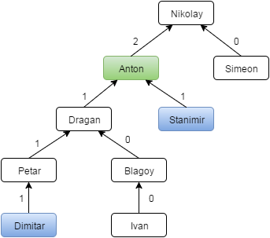
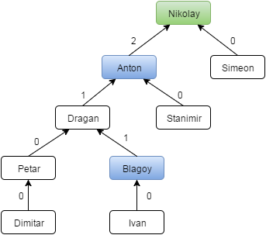
Lowest common ancestor
Dimitar and Stanimir => Anton
Blagoy and Anton => Nikolay

Slide 4
int LowestCommonLeader(currentElement, firstEmployee, secondEmployee)
{
…
employeesInLeftBranch = LowestCommonLeader(currentElement.LeftChild, firstEmployee, secondEmployee);
employeesInRightBranch = LowestCommonLeader(currentElement.RightChild,
firstEmployee, secondEmployee);
…
}

Slide 5
Have a nice evening!

